Slide 1

____________________________________
Commonwealth Nurses and Midwives Federation
Executive Secretary Report
26th CNMF Biennial Meeting of Members
Notes:
Countries within the Commonwealth are focused on achieving the Sustainable Development Goals and universal health coverage; reducing the impact on health systems of communicable and non-communicable diseases, and the effect on sustainable environments of climate change. The input of nurses and midwives is essential in all of these areas, and nurses and midwives, their associations, and their leaders have a responsibility to light the way.
This presentation outlines how the CNMF fulfills the mission entrusted to it by its members and shares key achievements in each of its seven strategic directions.

Slide 2

26th Commonwealth Nurses and Midwives Federation
Biennial Meeting
Thursday 26 September 2024
The CNMF Biennial Meeting of Members is the decision making body of the federation, setting the strategic directions for the ensuing two years
Notes:
The CNMF Biennial Meeting of Members is the governing and decision making body of the federation, setting the strategic objectives for the ensuing two years and giving direction to the CNMF Board and the Executive Secretary.
The other governance instruments are our constitution which is reviewed each two years before the Biennial Meeting of Members and our Policy Statements all of which are publicly available on our website.
In 2014, the constitution was amended to change the name of the federation from Commonwealth Nurses Federation to Commonwealth Nurses and Midwives Federation.
The Executive Secretary provides a quarterly report to CNMF Board Members and an Annual Report is also produced and uploaded to the website. The Annual Report includes the audited financial statements for the reporting period.

Slide 3
Commonwealth Nurses and Midwives Federation
____________________________________
    Governance
    Administration
    Membership
    Finances
    Communication
    Liaison
    Programs
http://www.commonwealthnurses.org
Notes:
In presenting my report to the 24th Biennial Meeting of Members, I want to take the opportunity to reflect on some of the changes that have taken place within the CNMF during the past 12 years I have been in the position of Executive Secretary. I am the 4th Executive Secretary of the CNMF and only the second who is a nurse and midwife, an essential criteria in my view for any incumbent of the position.
For me, it has been an amazing 12 years and I feel particularly blessed to have had the opportunity to lead the organisation and to work with nurses and midwives across Commonwealth countries. I have met amazing, dedicated people. I have been to wonderful places and had incredible experiences which I will always treasure. It has been such a privilege to have had the opportunity to use my knowledge and skill to work with countries to improve the working lives of nurses and midwives and ultimately contribute to improving the health of citizens of the Commonwealth.
These are the seven areas in the CNMF strategic plan which provide the structure for this report.

Slide 4
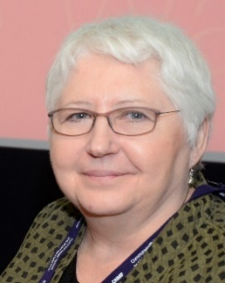
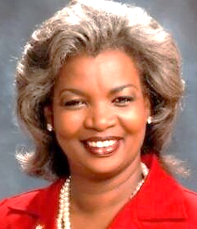
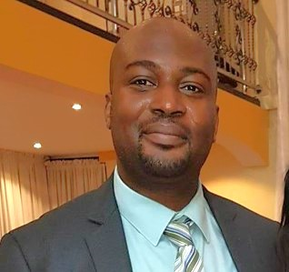
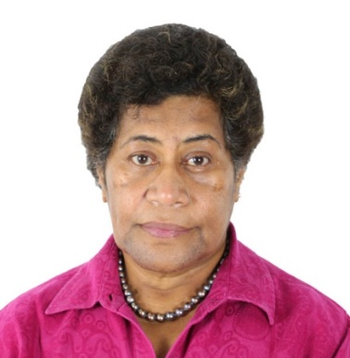
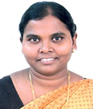
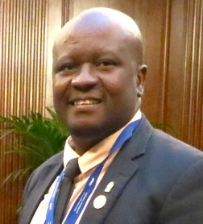
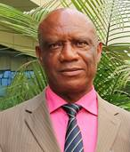
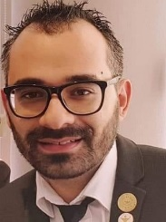
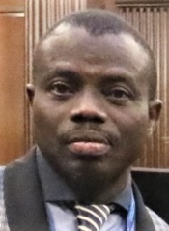
GOVERNANCE
CNMF Board
Notes:
The CNMF is governed by an elected Board who serve four year terms. The President and Deputy President are elected by all members. The Regional Board Members are elected by members in their own region.

Slide 5
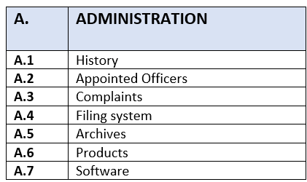
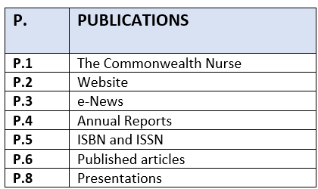
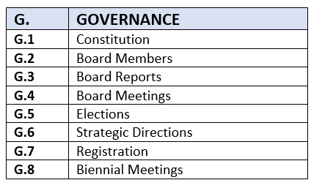
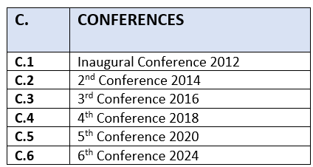
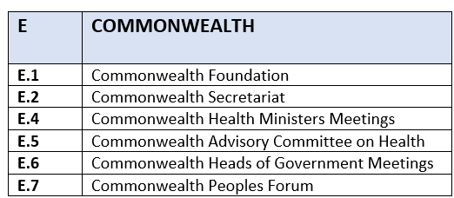
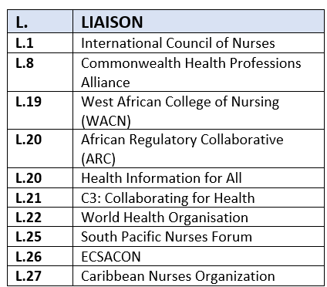
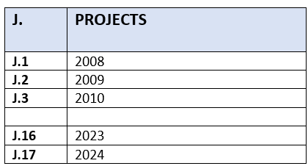
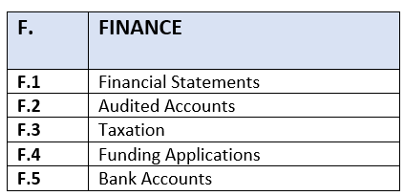
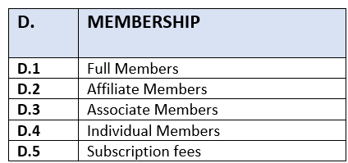
ADMINISTRATION

Slide 6
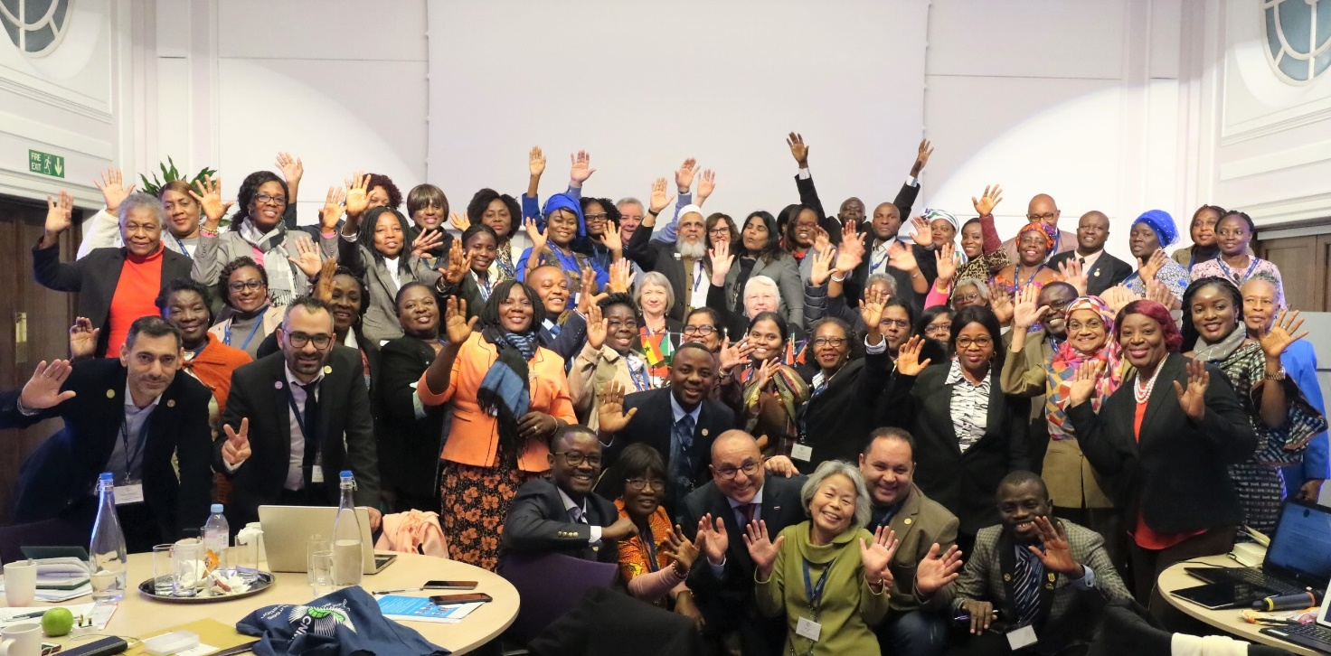
MEMBERSHIP

Slide 7
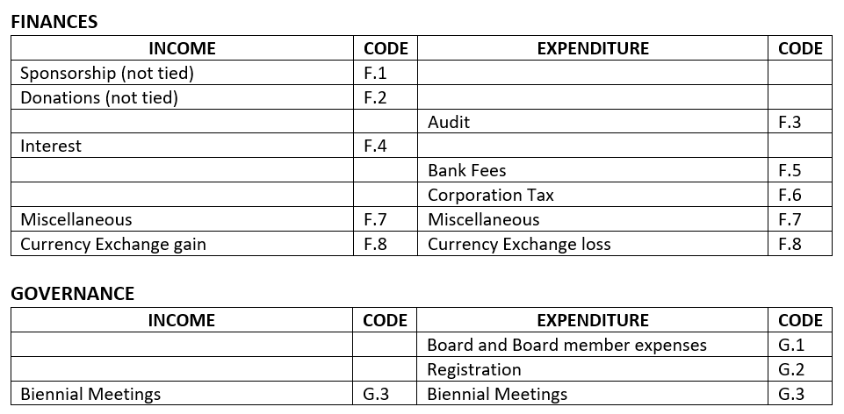
FINANCES

Slide 8
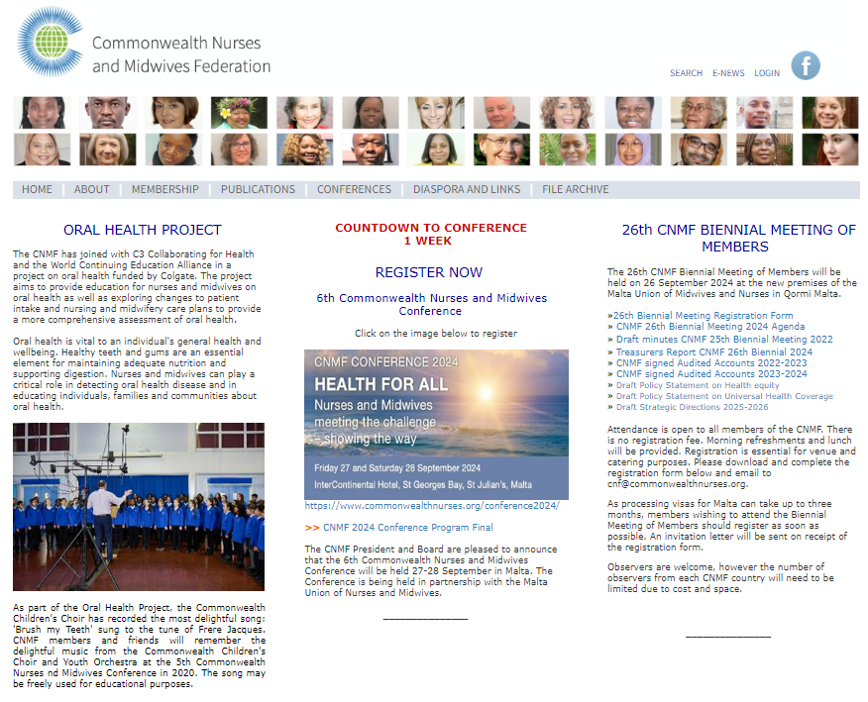
COMMUNICATION

Slide 9





LIAISON

Slide 10
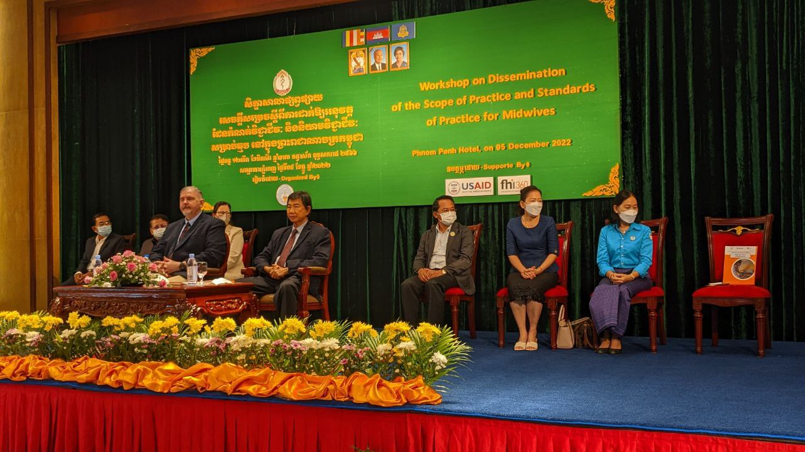
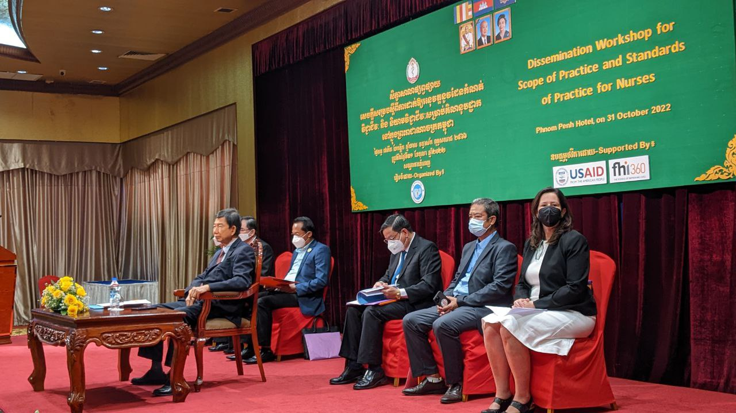
PROJECTS: Cambodia Regulation Project

Slide 11
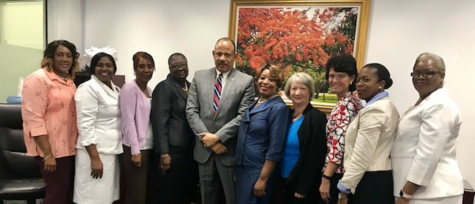
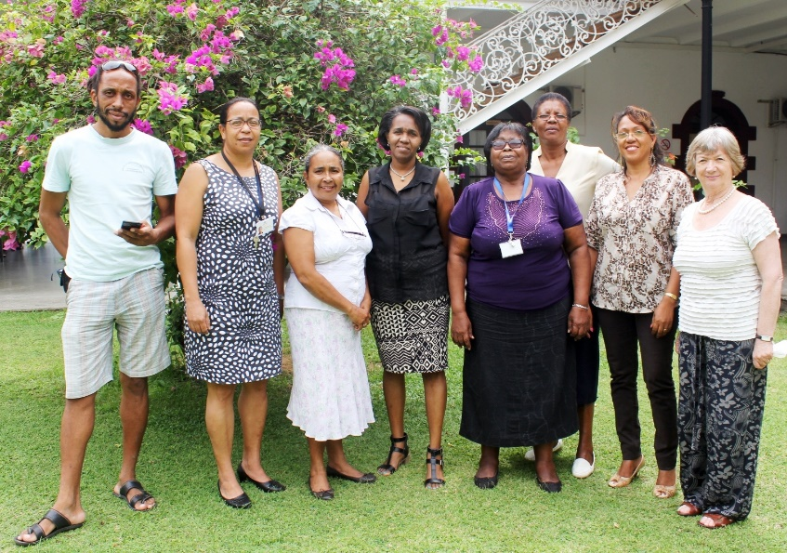
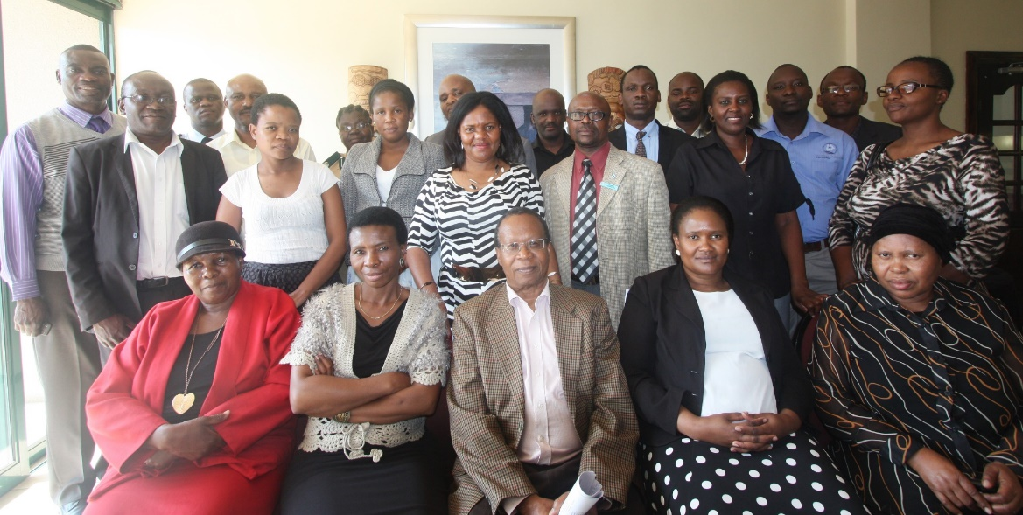
PROJECTS: Mental health legislation reform

Slide 12
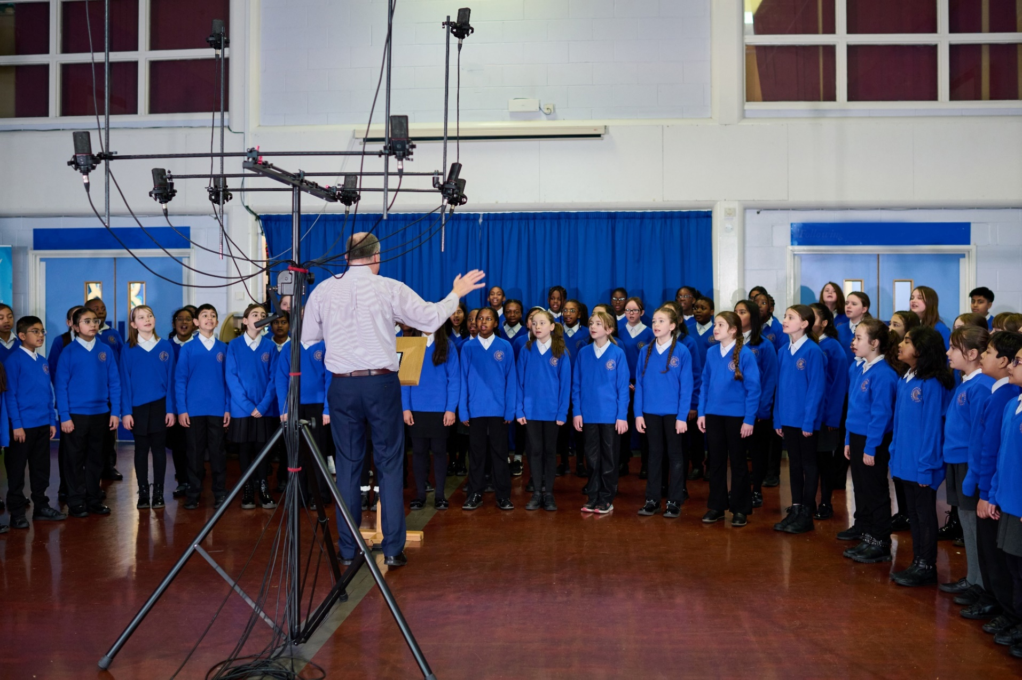
PROJECTS: Oral Health Project
https://www.youtube.com/watch?v=JFpqijlYc1s

Slide 13

NEXT STEPS

